Slide 1
Basics of Probability Theory

Slide 2
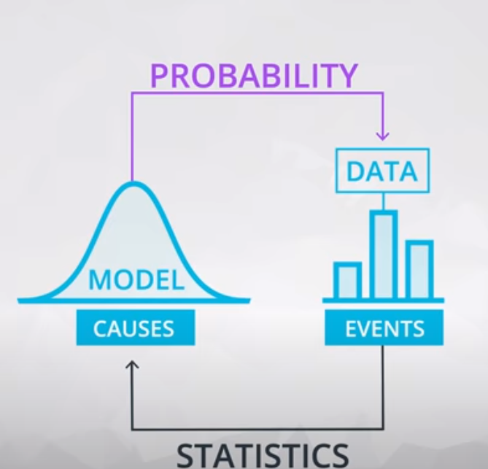
Probability Vs. Statistics
Probability: we are given description of causes & we are trying to predict data / future events
Statistics: we are given data & we are trying to infer possible causes
Probability is used to make inferences from samples to populations
Inferential Statistics uses Probability:
The chance of an event occurring
A measure of the likelihood that an event in the future will happen

Slide 3
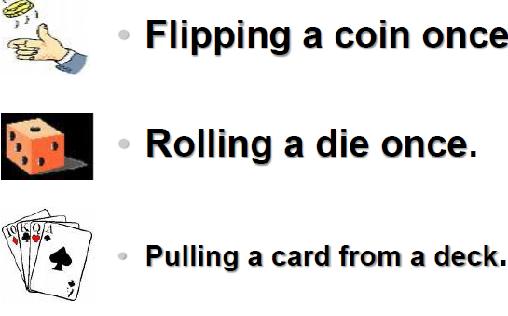
Probability Experiments
A random experiment is an experiment that can result in different outcomes, even though it is repeated in the same manner every time.
A probability experiment is a chance process that leads to well-defined results called outcomes. An outcome is the result of a single trial.”

Slide 4
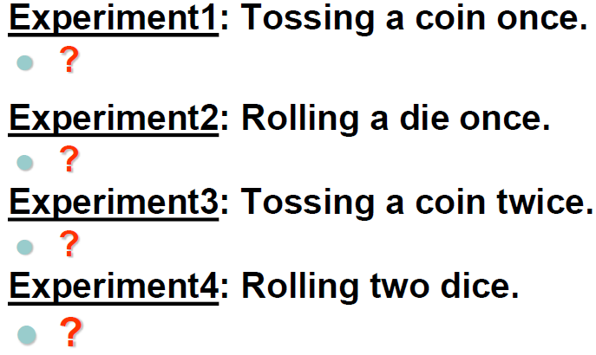
Sample Spaces
The set of all possible outcomes of a random experiment is called a sample space

Slide 5
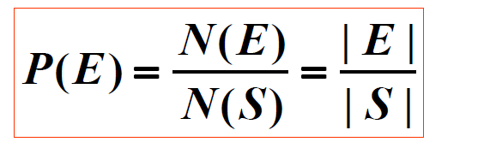

Classical Probability
The (classical) probability, P(E), of an event E is defined as:
N(E) or |E| = the number of elements in the set E.
The probability of an event E is a value, P(E), such that
The union ≡ or the intersection ≡ and of events are defined in a natural way
Note that:
P(A or B) = P(AUB) = P(A) + P(B) – P(A∩B)
P(A and B) = P(A.B) = P(A∩B)
It is assumed in the classical probability formula that all outcomes are equally likely to occur

Slide 6
Joint Probability
For Any two events A & B, The Joint Probability denoted by: “ P(A and B) = P(A.B) = P(A∩B)” measures the likelihood that the two events “A & B” will happen concurrently.
An example: would be the event that a student has both a stereo and TV in his/her dorm room.

Slide 7
Independent Events
Events are mutually exclusive means that the occurrence of any one event implies that none of the others can occur at the same time: i.e., P(A and B) = 0.
Events are independent if the occurrence of one event does not affect the occurrence of another “i.e., has no effect on the probability of the occurrence of the other”.
Definition: Events A and B are called Independent if P(A and B) = P(A).P(B)
Example: When drawing a card:
Drawing a club and drawing a heart are mutually exclusive events.
Drawing a club and drawing a king are not mutually exclusive events

Slide 8
Examples
If you flipped a coin 1 time, find the probability of getting a head.
If you flipped a coin 2 times, find the probability of getting two heads.
If you flipped a coin 3 times, find the probability of getting two heads and one tail.
Two dice are rolled. Find the probabilities of the following events.
1. Getting two even numbers.
2. Getting two numbers whose sum is 7

Slide 9
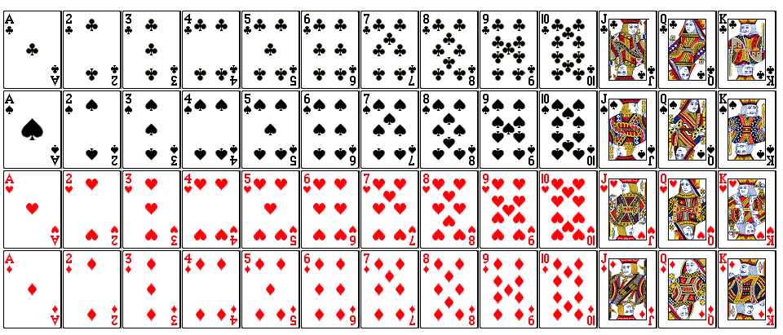
Examples
A card is drawn from a standard deck. Find the probabilities of the following events.
1. Getting a queen.
2. Getting a club.
3. Getting a number.

Slide 10
Examples
In a sample of 80 students, a questionnaire was out that: 45 students
of them studied English; 40 studied French; 35 studied German; 20 studied English
and French; 23 studied English and German; 19 studied French and German; and
12 students studied all. A student was chosen at random:
Find the probability that the student studied:
(a) Only English.
(b) Only German.
(c) English or French.
(d) Exactly one only of the three languages.
(e) One language at least.
(f) One language at most.
(g) Exactly two languages.
(h) German and French and did not study English.

Slide 11
COUNTING RULES
In a sequence of two experiments, if the first experiment can occur in m different ways and the second one can occur in n different ways, then the whole sequence can occur in “m x n” different ways. This is called “Basic Counting Rule”
Examples:
Suppose a business owner has a choice of 5 locations in which to establish her business. She decides to rank each location according to a certain criteria, such as price of store and parking facilities.
1- How many different ways she can rank the five locations.
2- If business owner wishes to rank only top three of the five locations, how many different ways she can rank them.
Consider the manufacturing of number plates consisting of two letters followed by four digits:
1- How many plates are possible?
2- How many plates are possible, if no letter or digit can be repeated?

Slide 12
COUNTING RULES
If a coin is flipped 9 times, find the probability that heads appear exactly 4 times.
It is clear that an efficient way to count outcomes in Large sample spaces is required.
The ISSUE is: HOW TO COUNT?!

Slide 13
HOW TO COUNT?
Given the four letters: A, B, C, and D.
In how many ways one can select 2 letters out of the given 4, assuming that the order is:
1. Required.
2. Not needed.
Given 2 coin flips, how many outcomes are there for #Heads = #Tails
Given 5 coin flips, how many outcomes are there for #Heads = #Tails
Given 5 coin flips, how many outcomes will have exactly 1 Heads
Given 5 coin flips, how many outcomes will have exactly 2 Heads
Given 10 coin flips, how many outcomes will have exactly 5 Heads

Slide 14
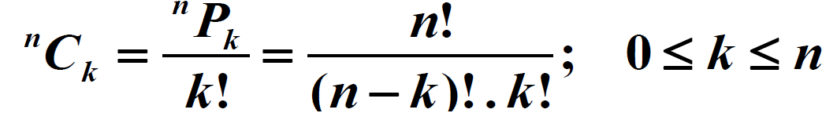
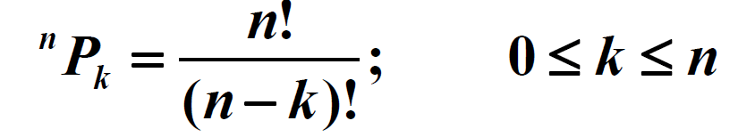

HOW TO COUNT? → Formulas
NO “Order” → Combination
With “Order”→ Permutation

Slide 15
Examples
What is the number of (possibly meaningless) words that are made up of all the letters in the word “chemistry”?
What is the number of permutations of the letters in the word “ball”?
What about the word “pepper”?
In a class of 10 students, three are to be chosen to represent the class in a competition. How many selections are possible?
The Jazz Club offers the following game: they play 3 songs out of a list of 10 songs. If you guess the right songs in the right order you win a free drink. What is the probability that you win?

Slide 16
Conditional Probability
The conditional probability is the probability of a particular event occurring, given that another event has already occurred before.
The probability of the event A given that the event B has occurred is written P(A|B).

Slide 17
Dependent Events
For any two events A and B, the joint probability “P(A and B)” that both events will happen is found by: multiplying the probability that event A will happen by the conditional probability of B given that A has already occurred first
if A occurred first:
if B occurred first:
This is the rule for DEPENDENT events

Slide 18
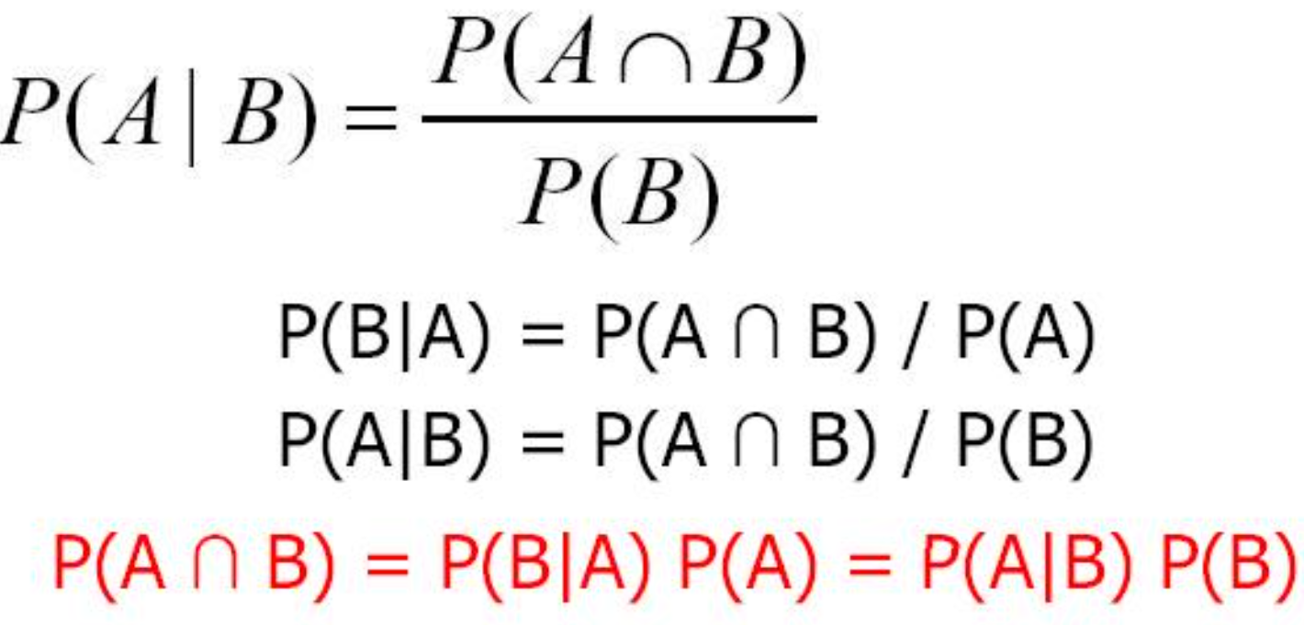
Conditional Probability
The conditional probability of an event A occurring given an event B “i.e., knowing that B has already occurred first” is given by:

Slide 19
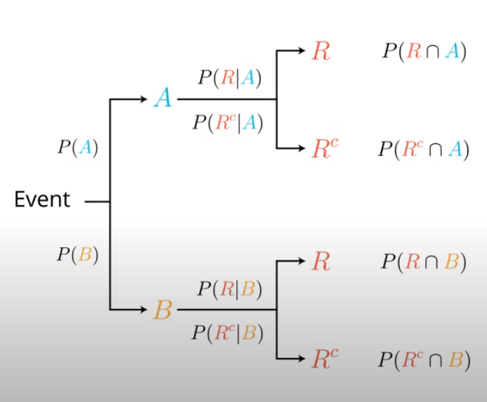
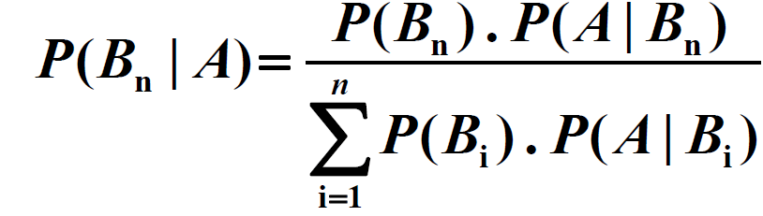
Bayes Theorem
The Bayes theorem describes the probability of an event based on the prior knowledge of the conditions that might be related to the event. If we know the conditional probability , we can use the Bayes rule to find out the reverse probabilities
It gives us a way to calculate P(B|A) from a knowledge of P(A|B)
Tree Diagram

Slide 20
Examples
Assume that we role a die once:
A is the event of getting an even number.
B is the event of getting a number “> 3”.
A & B are Independent?
In a box, there are 8 red and 3 green balls. We choose two balls randomly. Find the probability that:
1. Both balls are red.
2. Both balls are green.
3. First ball is red and the second ball is green.

Slide 21
Examples
Assume that we roll a die once. Let A be the event of having an even number; B1 is the event of having a number greater than 2; and B2 is the complement of B1.
Find: P(B1 |A)? (Note: Solve it using 3 different ways)

Slide 22
Random Variables
A random variable is a quantity “X” resulting from an experiment, by chance, can assume different values..
A random variable is a variable “X” that has a single numerical value determined by chance, for each outcome of a procedure.
If a sample space S is discrete, then every R.V. defined on S is also discrete, i.e. its range is countable (think of random counts for examples).

Slide 23
Discrete Random Variable
A Discrete Random Variable is a variable that can assume only certain clearly separated values.
A Discrete Random Variable has either a finite or countable number of values, where “countable” refers to the fact that there might be infinitely many values, but they can be associated with a counting process
Examples for discrete R.V:
The outcome of rolling a single die.
The number of boys in a family with three children.
The number of heads that appear when a coin is flipped three times.
The sum of the numbers on the dice, when k dice are rolled.

Slide 24

Binomial Distribution
A binomial experiment consists of a fixed number, n, of independent trials of a Bernoulli experiment (an experiment with only two outcomes).
A binomial random variable, X, represents the number of successes in n trials, so X can be a whole number between 0 and n
A Binomial Probability Distribution results from a procedure that meets all the following:
1.The procedure has a fixed number of trials.
2.The trials must be independent, meaning that the outcome of one trial does not affect the outcome of any other trials.
3.Each trial must have all outcomes classified into two mutually exclusive categories– a success or a failure.
4.The random variable counts the number of successes in a fixed number of trials.
5.The probability of success “fail” remains the same in all trials

Slide 25
Examples
A fair coin is tossed 10 times, what is the probability of getting:
1.Exactly 6 heads.
2.At least 6 heads
Consider a website with 100,000 users, 1000 users are highly active and we want to take a survey. You draw users at random and that everyone responds. If you send out 10 surveys, What is the probability that the number of highly active users in our sample is greater than or equal 2?

Slide 26

Geometric Distribution
An experiment consists of repeating independent Bernoulli trials, until the first success
A geometric random variable, X, represents the number of trials until the 1st Success
Since trials are independent, the count of the number of trials until the next success can be started at any trial without changing the probability distribution of the random variable

Slide 27
Negative Binomial Distribution
A negative binomial is a count of the number of trials required to obtain r successes
Recall that a binomial random variable is a count of the number of successes in n Bernoulli trials. That is, the number of trials is predetermined, and the number of successes is random
A negative binomial random variable is a count of the number of trials required to obtain r successes. That is, the number of successes is predetermined, and the number of trials is random
A binomial random variable, X, denote the total number of trials required to obtain r successes

Slide 28
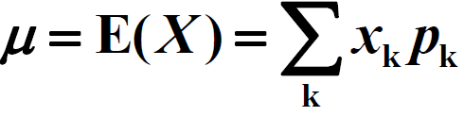
Expectation of a Random Variable
The expected value, or expectation, of a discrete random variable X is given by:
The formula gives a weighted average of values of a random variable, with the probabilities being the weights of the respective values
on average, how many bits must be received until the first (the r-th) error occurs?
you can take a sample, i.e. repeat the respective experiment several times and take the value of the RV each time.
Example:
Compute the mean of the number of girls in a family with 3 children

Slide 29
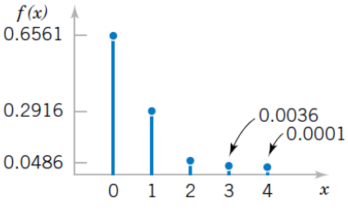
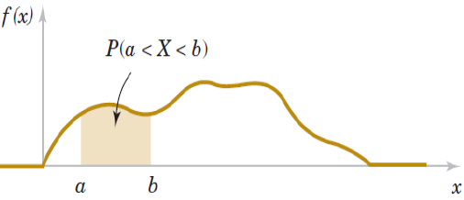

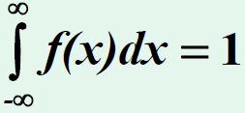
Continuous Random Variable
Examples for Continuous R.V:
The time between consecutive phone calls.
The current or voltage in an electric circuit.
Continuous VS. Discrete Random Variable
PMF
PDF

Slide 30


Examples
Consider any location X, assume that angle is random & so is the pressure, What is the probability of any specific X you might choose is the correct one?
Given a spinning bottle, what is the probability that the outcome X is between 0 and 180 degrees?
Given a spinning bottle, what is the probability that the outcome X is between 260 and 290 degrees?
Given a spinning bottle, what is the probability that the outcome X is between 179 and 180 degrees?

Slide 31
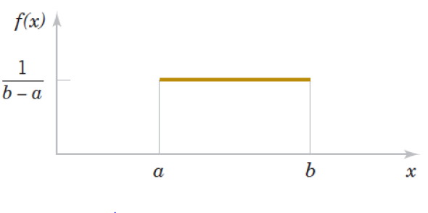
Uniform Distribution
It defines the probability density function of a continuous RV with a uniform distribution: rectangular shape its values spread evenly over the range of possibilities “defined on [a, b]”.
The probability of any interval is only dependent on its length!
Under certain conditions, the time, the distance, the weight etc. can be modeled using uniform distribution.

Slide 32
Examples
Time of day when people are born it is twice as likely to be born before noon. Draw the probability density function.

Slide 33
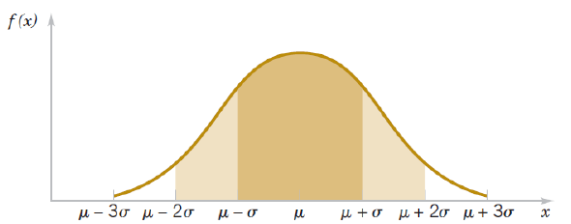
Normal Distribution (“N.D”)
The word “NORMAL” has a special meaning in Statistics, it refers to a specific bell-shaped distribution that can be described by the PDF of the N.D
The bell-shaped curve starts low, rises to a maximum, then decreases. it is symmetric
N.D. can be used to:
1.Describe a variety of variables.
2.Describe a sampling distribution of sample means.
3.Approximate other distributions “like Binomial” under certain condition

Slide 34
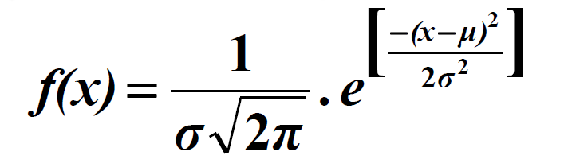
Normal Distribution (“N.D”)
Definition: A continuous R.V. that has a distribution with a symmetric and bell-shaped graph and described by the PDF
To compute probabilities for a normally-distributed continuous random variable, we have to integrate
Unfortunately, It not that easy to find the needed anti-derivative for f(x) in calculating infinite number of probabilities
We have to use the statistical tables.
These tables are available only for the so-called standard normal distribution

Slide 35
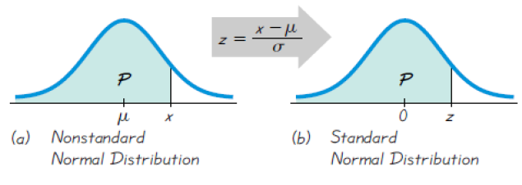
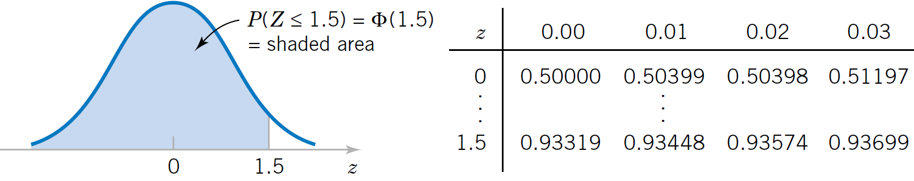
The Standard Normal Distribution
Definition: A normally distributed R.V. is said to have standard N.D if mean = 0 & standard deviation = 1

Slide 36
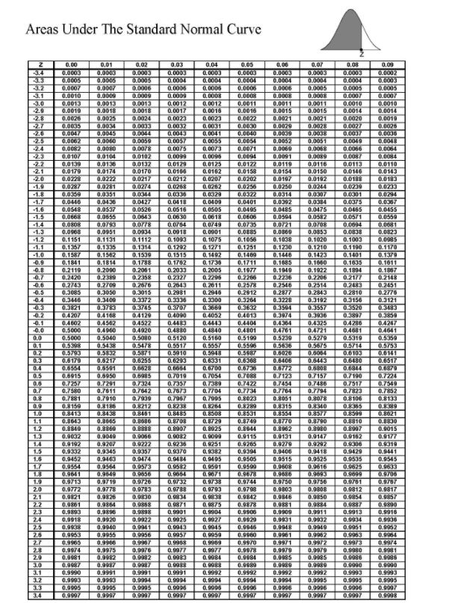
Example
Each month, an American household generates an average of 143 pounds of newspaper for garbage or recycling. Assume that standard deviation is 29 pounds. If a household is selected at random.
Find the probability if it generates
a)Between 140 and 211 pounds per month.
b)More than 174.9 pounds per month

Slide 37
Normal Distribution
What is the formula for figuring out the probability of the flip being heads?
For 1 coin flip | P
For many coin flips |  | Binomial Dist.
For infinitely many flips |  |  | Normal Dist.

Slide 38
Manipulating Normal Distribution
When adding two Gaussian distributions means are added and variance are added. Standard deviations are not added!
Example:
Suppose all salaries in a company are normally distributed, with mean of $60,000 and standard deviation of $10,000. If everyone is given a raise of $10,000. What is the new mean and standard deviation?

